Slide 1
Distributed Operating Systems (CS 30009)
UNIT_I_Lecture_2

Slide 2
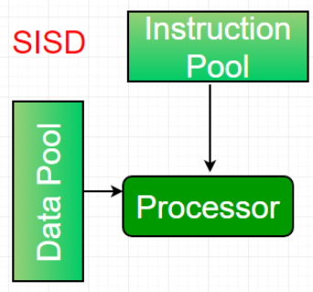
Hardware Concepts
Flynn’s taxonomy:
Based on the number of instruction and data streams that can be processed simultaneously, computing systems are classified into four major categories:
Single-instruction, single-data (SISD) systems:
An SISD computing system is a uniprocessor machine which is capable of executing a single instruction, operating on a single data stream.
In SISD, machine instructions are processed in a sequential manner and computers adopting this model are popularly called sequential computers.

Slide 3
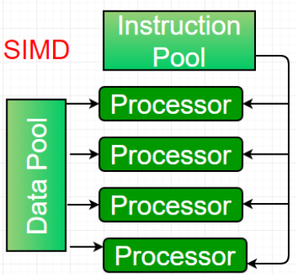
Cont..
Single-instruction, multiple-data (SIMD) systems –
An SIMD system is a multiprocessor machine capable of executing the same instruction on all the CPUs but operating on different data streams.
Machines based on an SIMD model are well suited to scientific computing since they involve lots of vector and matrix operations.

Slide 4
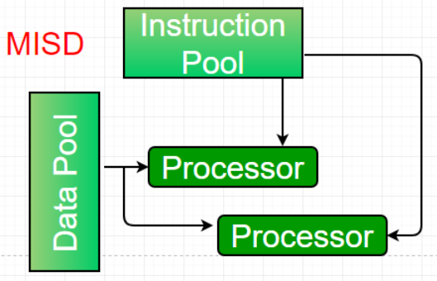
Cont..
Multiple-instruction, single-data (MISD) systems –
An MISD computing system is a multiprocessor machine capable of executing different instructions on different PEs but all of them operating on the same dataset.

Slide 5
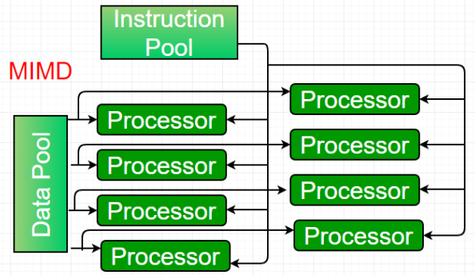
Cont..
Multiple-instruction, multiple-data (MIMD) systems:
An MIMD system is a multiprocessor machine which is capable of executing multiple instructions on multiple data streams.
A group of independent computers, each with its own program counter (PC), program, and data.
All distributed systems are MIMD.

Slide 6
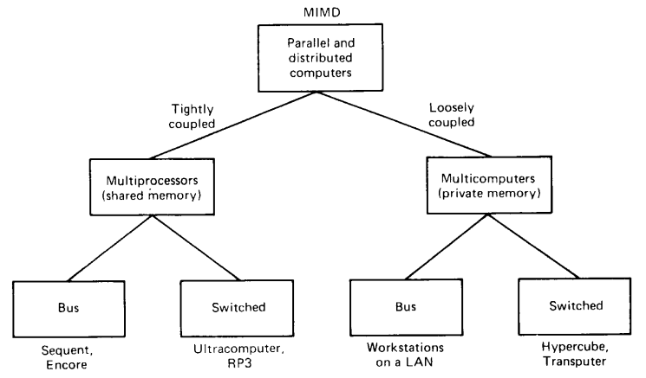
Cont..
In the figure shown below, MIMD computers are divided into two categories: those that have shared memory, usally called multiprocessors, and those that do not, sometimes called multicomputers.
In a multiprocessor, there is a single virtual address space that is shared by all the CPUs.
In contrast, in a multicomputer, every machine has its own private memory.

Slide 7
Cont..
Each of these categories can be further subdivided based on the architecture of the interconnection network: bus-based and switched-based.
In the bus-based architecture, there is a single network, backplane, bus, cable, or other medium that connects all the machines.
Example: Cable TV.
In the switched-based architecture, there are individual wires from machine to machine. Messages moves along the wires, with an explicit switching decision made at each step to route the message along one of the outgoing wire.
Example: PSTN
Multiprocessors are tightly coupled systems.
In a tightly coupled system, the delay experienced when a message is sent from one computer to other is short, and the data rate is high.
Multicomputer systems are loosly coupled system i.e., the intermachine message dely is high and the data rate is low.

Slide 8
Difference between Multiprocessors and Multicomputers
Sl. (Parameters) | Multiprocessors | Multicomputers
Memory | Single virtual address space that is shared by all CPUs | Every machine has its own private memory
2. Bus Architecture | There is a single network, backplane, bus, cable, or other medium that connects all the machines
2b. Switched Architecture | There are individual wires from machine to machine, with many different wiring patterns in use. Eg. Worldwide public telephone system
3. Coupling | Tightly coupled | Loosely coupled
4. Communication time | Short | Long
5. Data rate | High | Low

Slide 9
Cont..
Bus-based multiprocessors:
It consists of some number of CPUs all connected to a common bus, along with a memory module.
A typical bus has 32 or 64 address and data lines and more than 32 control lines, all of which operate in parallel.
To read a word of memory, a CPU puts the address of the word it wants on the bus address lines, then puts a signal on the appropriate control lines to indicate that it wants to read.
The memory responds by putting the value of the word on the data lines to allow the requesting CPU to read it in.
Since there is only one memory, if CPU A writes a word to memory and then CPU B reads the word back a microsecond later, B will get the updated value. A memory that has this property is said to be coherent.
The problem with this scheme is that with as few as 4 or 5 CPUs, the bus will usally be overloaded and performance will drop drastically.

Slide 10
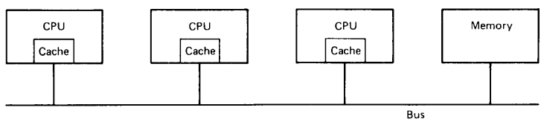
Cont..
The solution is to add a high-speed cache memory between the CPU and the bus.
The cache holds the most recently accessed words.
All memory request go through the cache. If the word requested is in the cache, the cache itself responds to the CPU and no bus request is made.
If the cache is large enough, the probability of success, called the hit rate, will be high, and the amount of bus traffic per CPU will drop drastically, allowing more CPUs in the system.

Slide 11
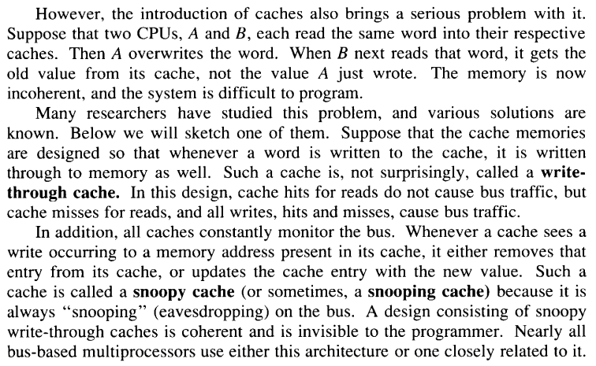
Cont..

Slide 12
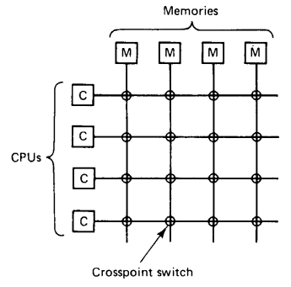
Cont..
Switched Multiprocessors:
To build a multiprocessor with more than 64 processors, a different method is needed to connect the CPUs with memory.
One possibility is to divide the memory up into modules and connect them to the CPUs with a crossbar switch as shown below.

Slide 13
Cont..
Each CPU and each memory has a connection coming out of it.
At every intersection, is a tiny electronic crosspoint switch that can be opened and closed.
When a CPU wants to access a particular memory, the crosspoint switch connecting them is closed momentarily, to allow the access to take place.
The virtue of the crossbar switch is that many CPU can be accessing memory at the same time, although two CPUs try to access the same memory simaltenously, one of them will have to wait.
The downside of the crossbar switch is that with n CPUs and n memories, n² crosspoint switches are needed.
To overcome this “Omega networks” can be used as shown in the next slide.
This network contains four 2 X 2 switches, each having 2 inputs and 2 outputs.
Each switch can route either input to either output.

Slide 14
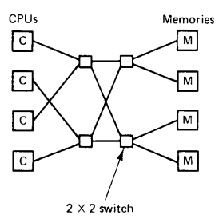
Cont..
In the general case, with n CPUs and n memories, the Omega network requires log₂n switching stages, each stage containing n/2 switches, for a total of (nlog₂n)/2 switches.

Slide 15
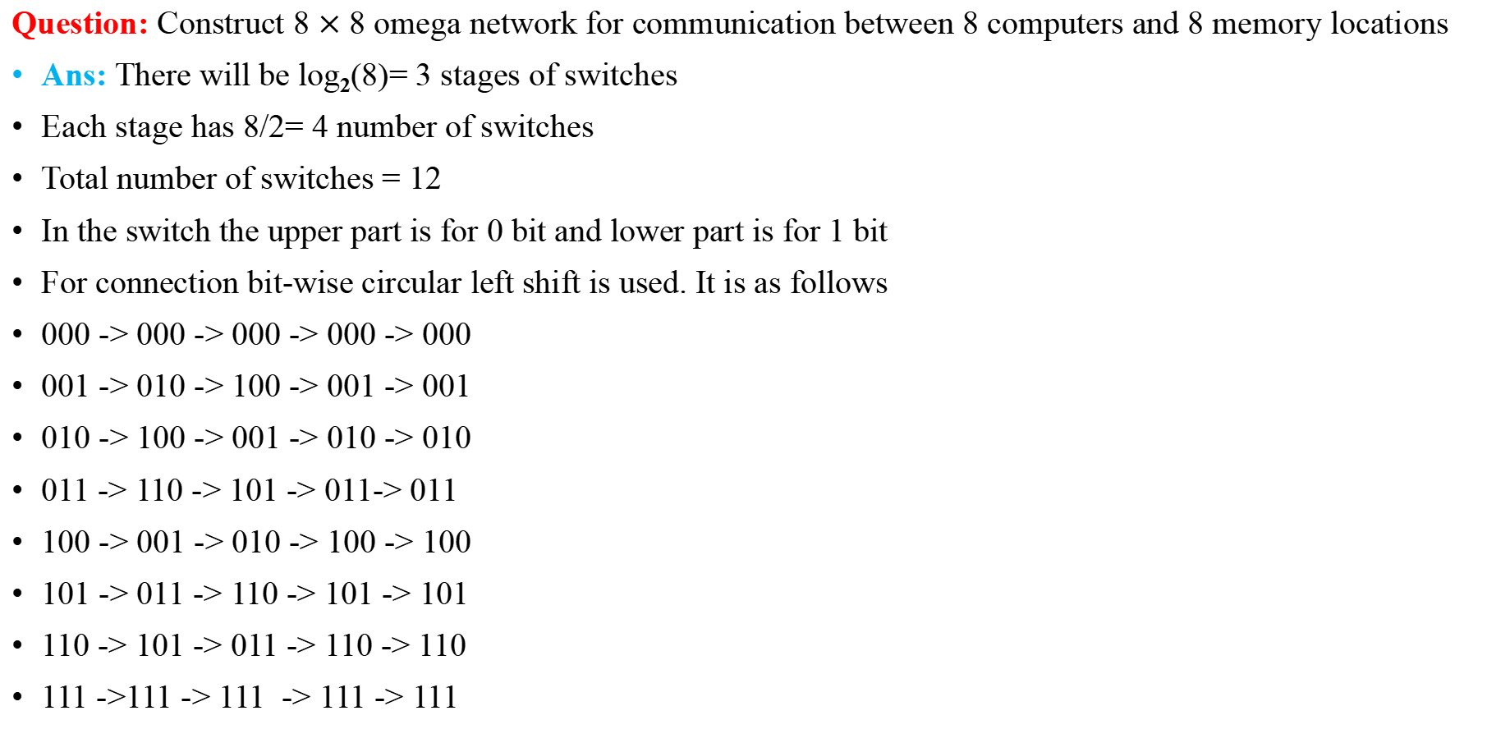
Cont..
Question: Construct 8 $×$ 8 omega network for communication between 8 computers and 8 memory locations
Ans: There will be log₂(8)= 3 stages of switches
Each stage has 8/2= 4 number of switches
Total number of switches = 12
In the switch the upper part is for 0 bit and lower part is for 1 bit
For connection bit-wise circular left shift is used. It is as follows
000 -> 000 -> 000 -> 000 -> 000
001 -> 010 -> 100 -> 001 -> 001
010 -> 100 -> 001 -> 010 -> 010
011 -> 110 -> 101 -> 011-> 011
100 -> 001 -> 010 -> 100 -> 100
101 -> 011 -> 110 -> 101 -> 101
110 -> 101 -> 011 -> 110 -> 110
111 ->111 -> 111 -> 111 -> 111

Slide 16
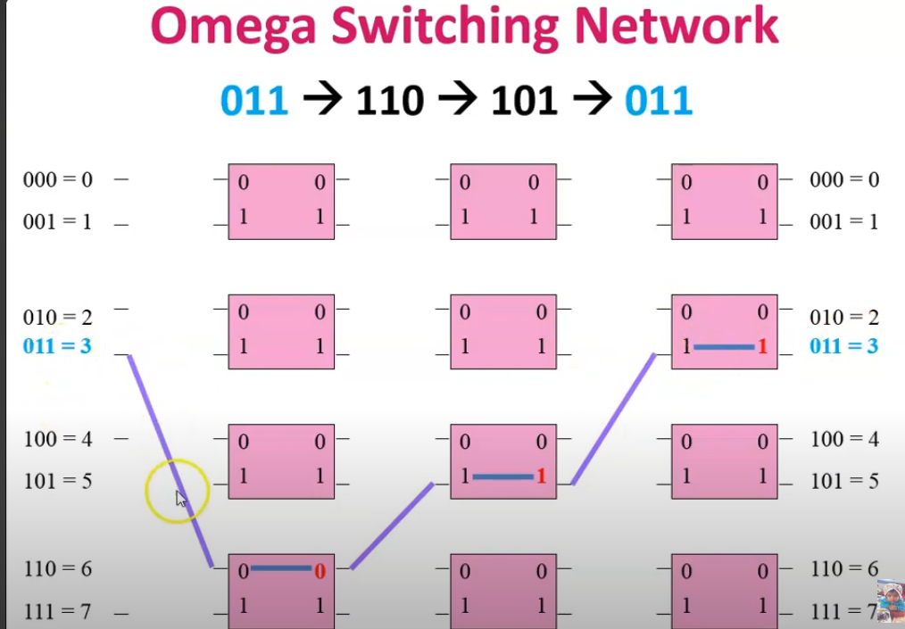

Problem: Omega Switched Network (8 $×$8) cont.
Explanation: 100 -> 001 -> 010 -> 100 -> 100 (bitwise-left-shift for switches)
Computer Stage1 Stage2 Stage3 Memory
C : 000
0
M : 000
000 -> 000 -> 000 -> 000 -> 000
001 -> 010 -> 100 -> 001 -> 001
010 -> 100 -> 001 -> 010 -> 010
011 -> 110 -> 101 -> 011-> 011
100 -> 001 -> 010 -> 100 -> 100
101 -> 011 -> 110 -> 101 -> 101
110 -> 101 -> 011 -> 110 -> 110
111 ->111 -> 111 -> 111 -> 111
0
0
0
0
0
C : 001
1
1
1
1
1
1
M : 001
C : 010
M : 010
0
0
0
0
0
0
C : 011
1
1
1
1
1
M : 011
1
C : 100
M : 100
0
0
0
0
0
0
C : 101
1
1
1
1
M : 101
1
1
C : 110
M : 110
0
0
0
0
0
0
C : 111
1
1
1
1
1
1
M : 111

Slide 17
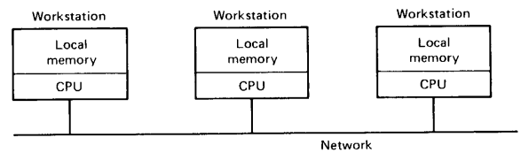
Cont..
Bus-based multicomputers:
In bus-based multicomputer system it is required to communicate CPU-to-CPU. This requires high-speed backplane bus.
It is a collection of workstations on a LAN, where each system has its own local memory. No shared memory.
Speed is 10-100 Mbps

Slide 18
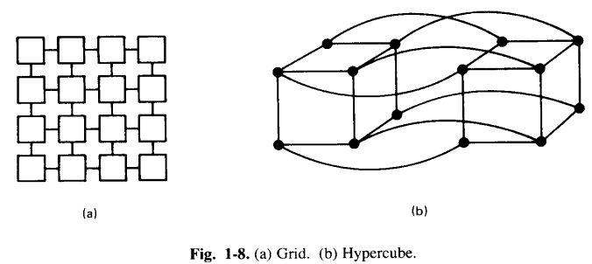
Cont..
Switched Multicomputers:
Figure below shows two popular categories of switched multicomputers: a grid and a hypercube.
Grid are easy to lay out on printed circuit boards.
They are best suited to problems that have an inherent 2D nature such as graph theory and vision computing.

Slide 19
Cont..
A hypercube is an n-dimensional cube.
The hypercube shown in previous slide is 4D cube.
Each vertex is a CPU. Each edge is a connection between two CPUs.
The corresponding vertices in each of the two cubes are connected.

